Slide 1
UNIVERSIDAD AUTÓNOMA DEL ESTADO DE HIDALGO
Instituto de Ciencias Económico Administrativas

Slide 2
Coordinación de Inglés
Tema: First Conditional
Profesor:
Clemente Licona Durán
Periodo: Enero Junio 2018

Slide 3
Objetivo general de la asignatura
El alumno podrá entender y compartir información acerca de experiencias y logros, expresar sentimientos y cantidades, enfatizar hechos, expresar situaciones que evidencian una relación causa-efecto, así como describir acciones y vincular sus ideas en el discurso, manteniendo una interacción social de sucesos pasados en relación con el presente, de acuerdo al contexto socioeducativo.

Slide 4
Objetivo de la unidad de trabajo
Enunciar una relación causa-efecto en el presente y en el futuro; así como expresar cantidades correctamente al escribir una nota o al intercambiar ideas de manera oral.

Slide 5
What will happen if you don´t take care of the planet?

Slide 6

Language discovery

Slide 7
Presentation
If climate changes, we will have to live in a different way
If emissions continue to rise unchecked, the climate disaster will be so severe
If the the global warming continues growing, the oceans will rise
Cities will be underwater if the seas rise too high
If it happens, we will have to adapt to it

Slide 8
Explanation
The first conditional is used to talk about things which might happen in the future.
It has the present simple after 'if', then the future simple in the other clause.
if + present simple, ... will + infinitive
If the seas rise too high, cities will be underwater

Slide 9
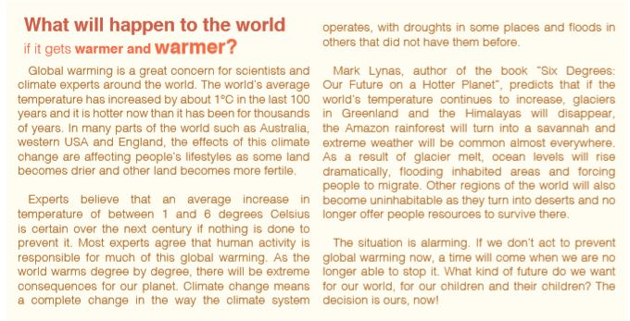
Identify the sentences

Slide 10
Complete the sentences with the correct form of the verb in brackets
If he studies hard, he _________________ (pass) his exams
She will come to your party if you ______________(ask) her
If you do not work, you _______________ (not get) a payment
If she _______________ (go) to Mexico City, she will visit the Zócalo
If I have a headache, I _______________ (take) an aspirine
My fríend will study Medicine, when he ________________ (finish) highschool
Peter will marry, If Mary __________________ (accept)
My father _______________ (go) to USA, if he gets the American visa
They ___________________ (play) next Sunday, if they win the next match.
If she has a good score in English, she ________________ (get) a certificate.

Slide 11
Production
Write some of your ideas about the following question:
What will happen if the global warming continues growing?

Slide 12
Referencias Bibliográficas
Davies, P. (2016). Make it real! Professional. Pachuca: UAEH University Press.

